Slide 1

Windows Azure BizTalk Services*
…in Preview!
*earlier referred to as “Windows Azure Service Bus EAI and EDI LABS”

Slide 2


Saravana Kumar
Founder & CTO –
Microsoft Integration MVP (since 2007)
http://blogs.biztalk360.com (11k readers)
@saravanamv

Slide 3
What’s the problem?
SalesForce for CRM
SAP ERP System for HR
Trading Partner data via FTP
Oracle DB for Customer Master Data
Internal Web Services - SOA
Web/Mobile Front-End

Slide 4
How BizTalk Server can Help?
SalesForce for CRM
SAP ERP System for HR
Trading Partner data via FTP
BizTalk Server
Oracle DB for Customer Master Data
Internal Web Services - SOA
Web/Mobile Front-End

Slide 5
Integration choices
WebAPI & WCF
Workflow
Service Bus
BizTalk Server 2013
BizTalk Services
Frameworks for building interoperable web services and APIs.
A framework for implementing long-running processes. Capability to build custom designer experience to allow users to modify workflow without programming.
A messaging infrastructure that allows applications to communicate by exchanging messages. Improves interoperability, scale and resiliency. Available in Windows Azure as well as Windows Server.
A full-featured Enterprise Integration server. Supports industry standards, capabilities and patterns such as Business Process Management, Enterprise Service Bus, Business Rules, Business Activity Monitoring (BAM), EDI, etc.
A Microsoft-managed (PaaS) integration service that offers full EDI processing, cloud application integration, and hybrid connectivity to on-prem LOB systems. Built on a dedicated secure environment.
WebAPI: Use for building HTTP-based and Restful APIs
WCF: Use for supporting SOAP and WS-* protocols, including security, reliable messaging, and transactions.
Best for building custom workflow experience into your enterprise applications or ISV solutions. For example, SharePoint workflow is built on WF.
Use for connecting loosely coupled components and applications . Supports both build-your-own inter-app as well as cross enterprise messaging scenarios.
Use for coordination of mission-critical business processes and integrating across multiple enterprise LOB systems and/or business partners. Best for highly reliable asynchronous processes.
Use for cloud-based integration solutions that require message mediation, enrichment and routing to enterprise line of business systems. Use trading partner management for supplier onboarding and collaboration.
5

Slide 6




Bring the Cloud to your Enterprise:
Integration
Windows Azure
SaaS
Apps
Partners
Integration
Your
Data
Center
applications
mainframe
servers
databases

Slide 7
Microsoft Integration Stack
IaaS
PaaS
Microsoft BizTalk Server 2013
Microsoft BizTalk Server 2013
Windows Azure BizTalk Services (WABS)

Slide 8


Light Weight Integration
Service Bus
Registration Message
Month=‘July’
Cloud Application
Registration Message
Month <> “July”
Blob
Registration Message

Slide 9
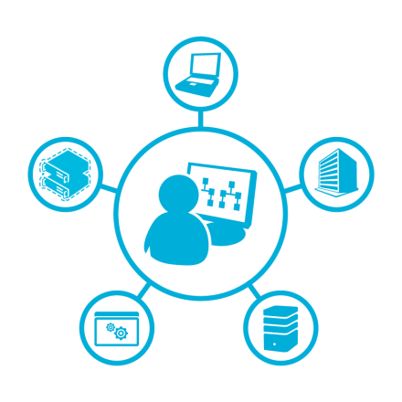



Windows Azure BizTalk Services
Managed Service
Configuration Driven
Dedicated Deployment
Extensible Platform

Slide 10
Windows Azure BizTalk Services
EAI Service
      Drag and drop integration solution development
      Out of the box support for common integration patterns
      Connectivity to on-premises LOB systems out of the box
EDI - B2B Service
      Trading partner management and supplier on-boarding
      Support for X12 and AS2
Extensible Platform
      Rich message processing
      Customization with code for transforms and pipeline stages
      Trading Partner Management API for custom experiences

Slide 11
Pricing
 | DEVELOPER | BASIC | STANDARD | PREMIUM
Price (Preview) | $0.065 /hour (~$48/month) | $0.335 /hour (~$249/month) | $2.015 /hour per unit (~$1,499/month) | $4.03 /hour per unit (~$2,998/month)
Production Use | Not available for use in production | Yes | Yes | Yes
Scale Out | N/A | N/A | Up to 4 units | Up to 8 units
EAI Bridges per unit | 30 | 50 | 125 | 250
Number of connections using BizTalk Adapter Service | 1 | 0 | 5 | 25
EDI Agreements per unit | 10 | 0 | 0 | 1000
Availability SLA | No | Yes for GA, No for Preview | Yes for GA, No for Preview | Yes for GA, No for Preview

Slide 12
BizTalk Service
Key concepts

Slide 13
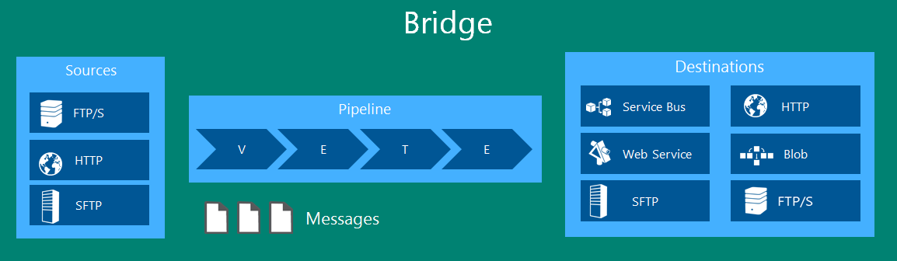
Bridges in BizTalk Services
Basic building block for building your integration platform
A Bridge is a single message processing unit with 3 parts:
  Sources: From where the messages originate
  Pipeline: Which processes the messages [Flat file, XML, Pass-through]
  Destinations: Where the messages are sent to

Slide 14
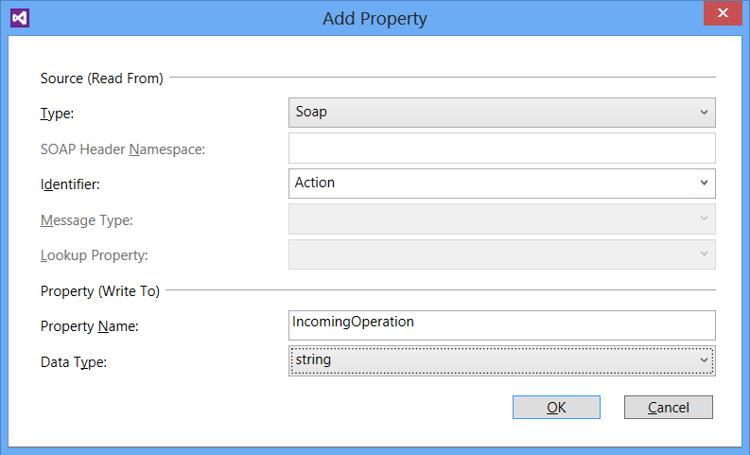
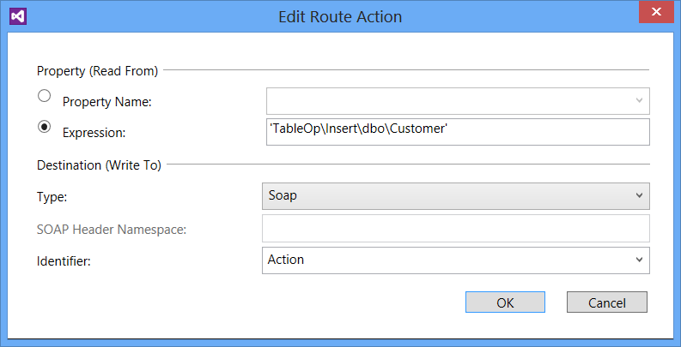
Property
Any interesting data in your message
Defined in the Enrich stage of a pipeline
Can be tracked as part of message processing
Property source could be from:
Transport headers/properties
A part of the message (specified using XPath)
An external data lookup
System properties
Use in Filter Rules/Actions for routing or in Maps
Supported destinations auto-convert properties into meta data

Slide 15
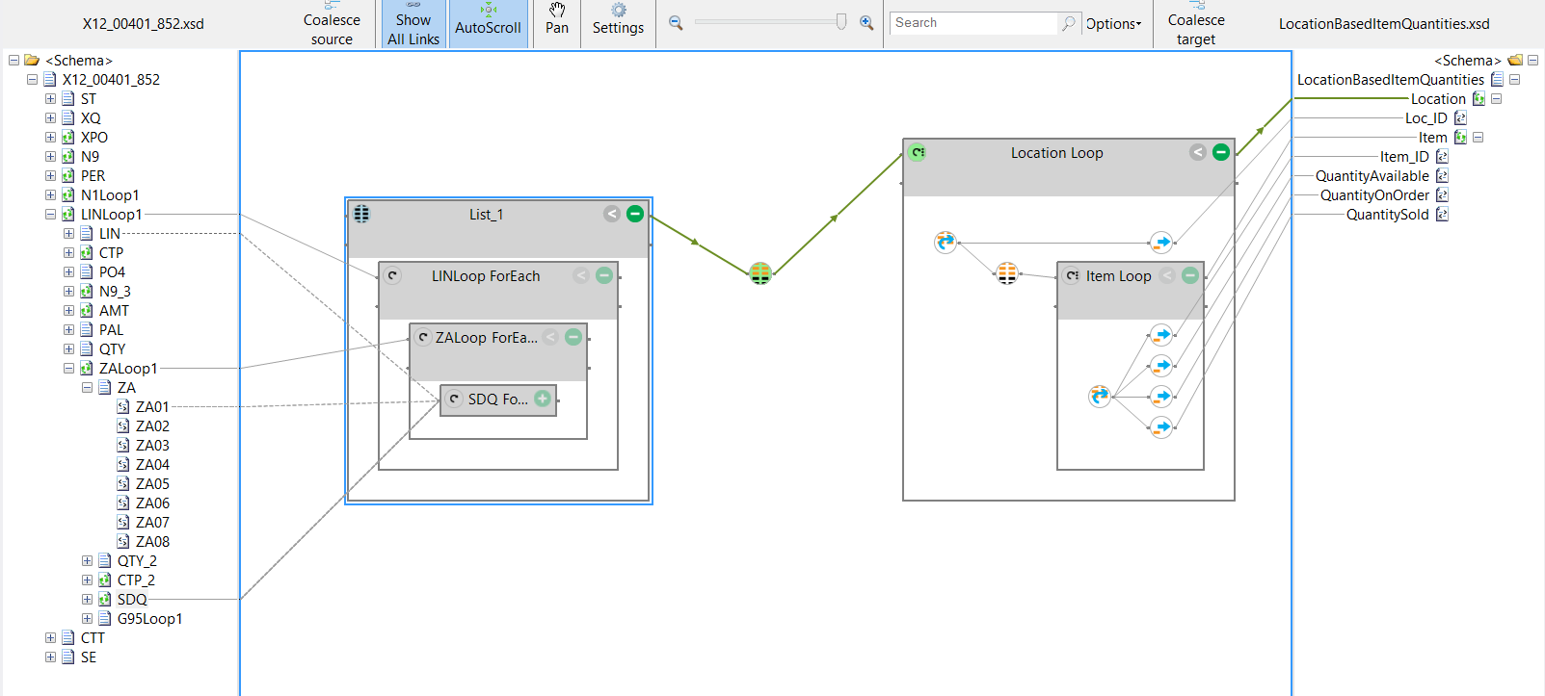
Transformation
Graphical UI tool to define your map
OOB Support for more than 35 operations
Supports custom XSLT and inline C# scripts
Test the map locally and validate the output as well

Slide 16
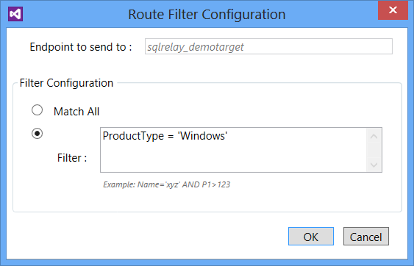
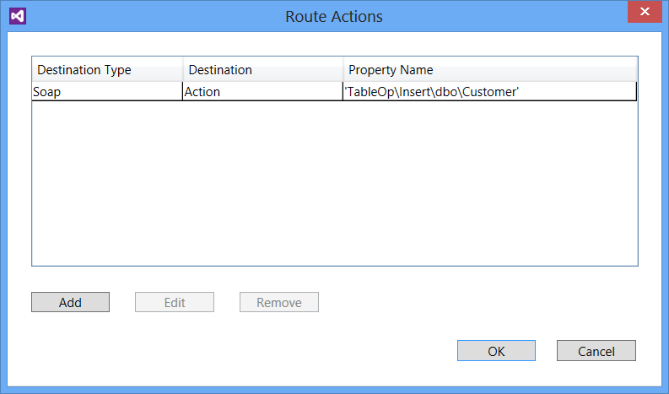
Routing
Rule based routing
Message delivered to first matching destination
Rules use the same SQL92 syntax used in Service Bus Topic/Subscription Rules
Route Actions may be used to write destination specific headers

Slide 17
Hybrid Connectivity
Service Bus
Month=‘July’
Cloud Application
Month <> “July”
Blob
Month = “August”
Service Bus
BizTalk Adapter Service
Server Explorer
(Visual Studio)
Lob Relay (Service Host)
Management Service
Lob Target
Lob Target
REST API
PowerShell CmdLets
Database
ERP

Slide 18

Internally all these technologies are interconnected
  BizTalk Services utilizes and extends Service Bus
  BizTalk Services utilizes WF for bridge runtime
  BizTalk Server leverages Service Bus for easy SaaS connectivity
  WF Manager uses Service Bus for messaging

Slide 19


Contacts
  saravana.kumar@biztalk360.com
  http://uk.linkedin.com/in/saravanamv
  @saravanamv
  http://blogs.biztalk360.com
www.biztalk360.com

