Slide 1
Saravana Kumar
Founder – Serverless360 / Microsoft MVP - Azure
Your Azure Serverless Applications Management and Monitoring simplified using Serverless360

Slide 2
AGENDA
1 Management of your Serverless Apps
2 Improving DevOps for your Serverless Apps
3 End-to-End tracking for your Serverless Apps
4 Customer Scenarios

Slide 3
What is a Serverless App?
Azure Logic Apps
Azure Functions
Azure APIM
Azure Service Bus (Queues, Topics)
Azure Relays
Azure Event Grid
Azure Event Hub
Azure Storage Queues, Tables, Files
Azure Web Apps
Azure SQL Database
Serverless Apps are built like LEGO blocks

Slide 4
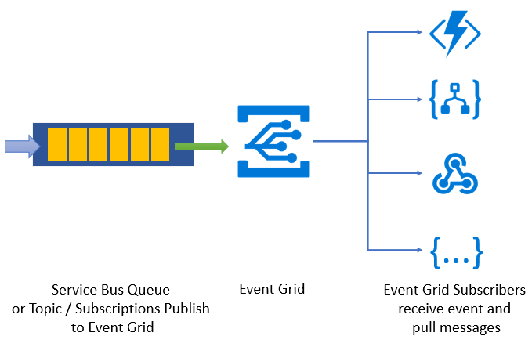
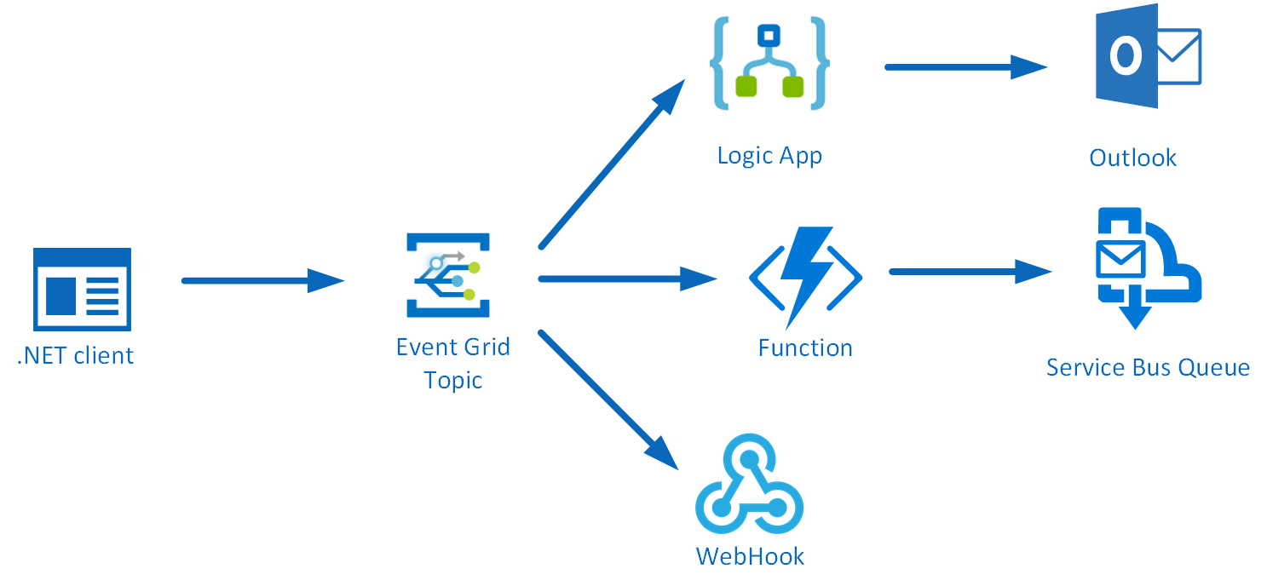
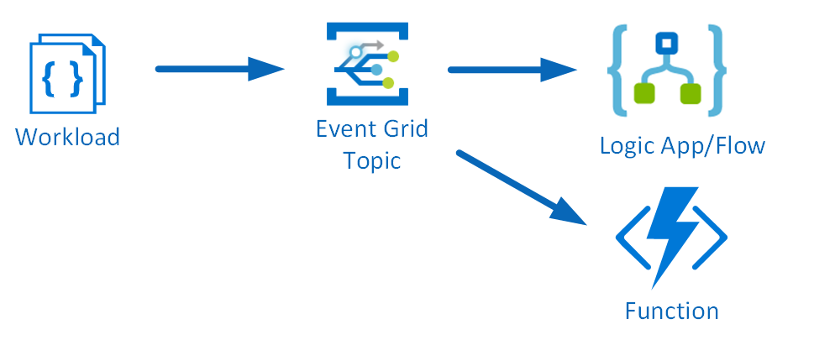
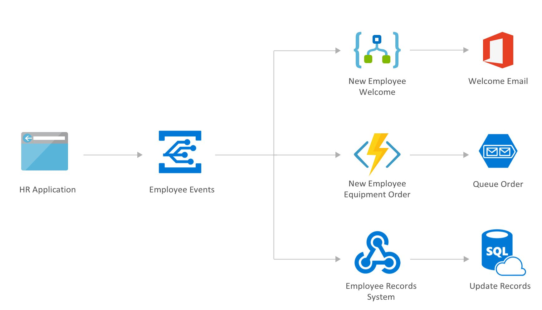
Examples of Serverless App

Slide 5
Your Serverless apps are really up in the air (cloud)

Slide 6
Management of your Serverless Apps
PROBLEMS
1 No visibility and Hard to manage
2 Complex to diagnose and Troubleshoot
3 Hard to secure and monitor

Slide 7
We see same problem in modern applications

Slide 8
Azure Portal is too powerful for production suport

Slide 10
1. Management of your Serverless Apps
SOLUTIONS
1 Composite Applications & Hierarchical Grouping
2 Service Map to understand the architecture
3 Security & Monitoring under the context of application

Slide 11
Serverless360 is your replacement for Azure Portal
(to improve your day to day operations work)
Notes:
Queries & traceability
Exception monitoring
Tracking monitoring
Reprocess

Slide 12
2. DevOps Improvements (Automate Everything)
1 Templated entity creation
2 Auto process left over messages
3 Auto process dead letter messages
4 Remove storage blobs on condition
5 Replicate QA to Production
6 Detect & Auto correct entity states

Slide 13
3. BAM (End-to-End Tracking)
Where is my Message?
(Driver Validation, PO, Booking Status)
Notes:
Queries & traceability
Exception monitoring
Tracking monitoring
Reprocess

Slide 14
4. Customer Scenario’s
1 Ensure 15k client devices are active (using Data Monitoring)
2 Monitoring solutions specific to different teams (composite application + monitoring)
3 Auto Reschedule Doctors appointments (using dead letter processing)

Slide 15
Book a Demo
https://www.serverless360.com
Or
Come and see us in the Exhibit area

Slide 16
Q & A

