Slide 1

Michael Stephenson
Microsoft MVP - Azure
Lowering the TCO of your Serverless solution with Serverless 360

Slide 2
We don’t have time to train and get the experience we need with the technologies we are using
I cant find enough good people with experience on Azure
The experienced people I have are maxed out but too much support
Support Manager
CTO
Project Manager

Slide 3
The case for democratizing support
Its key to being mature and successful with the cloud

Slide 4
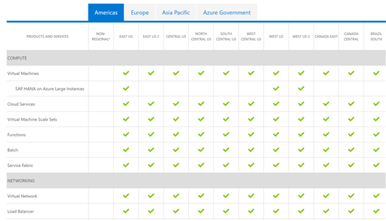
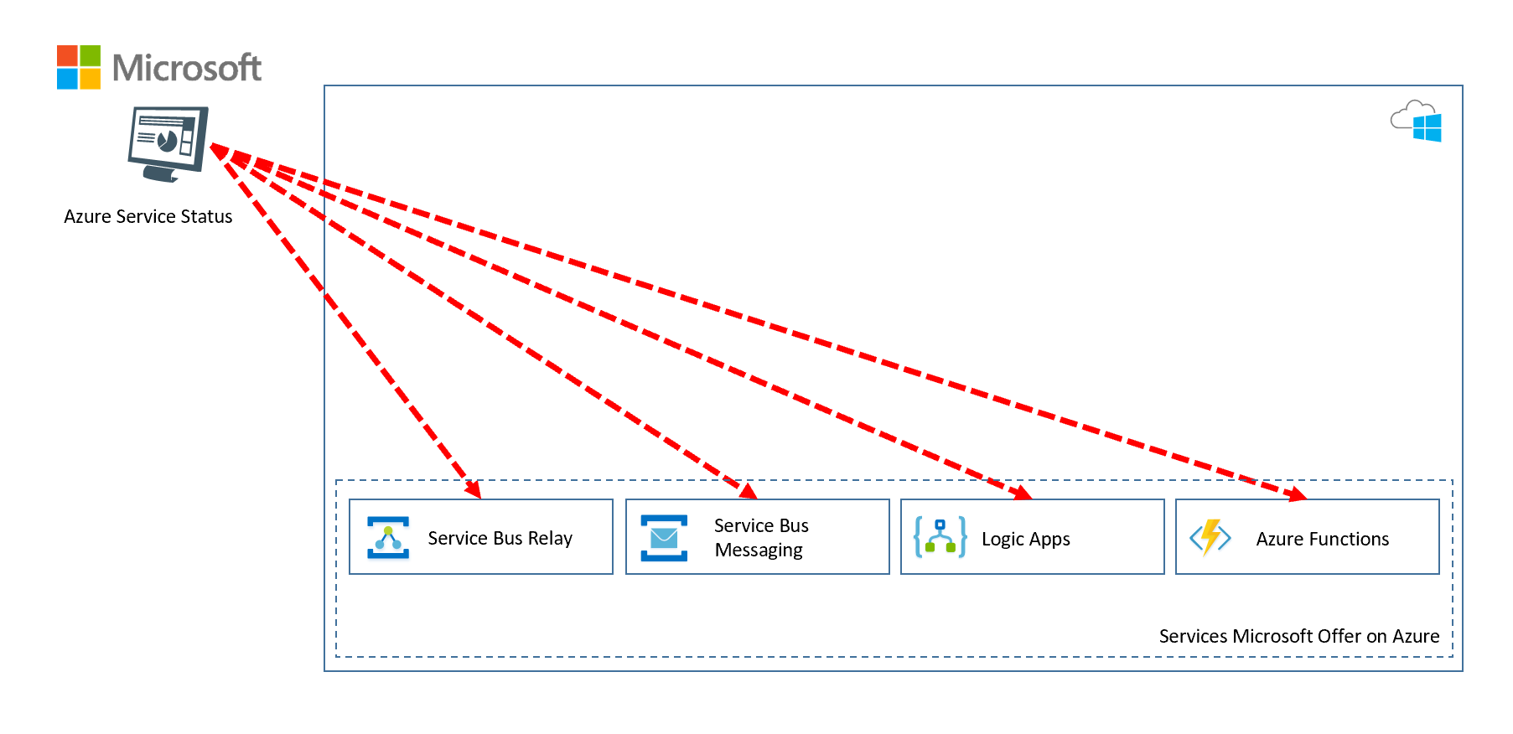
What Microsoft does?

Slide 5
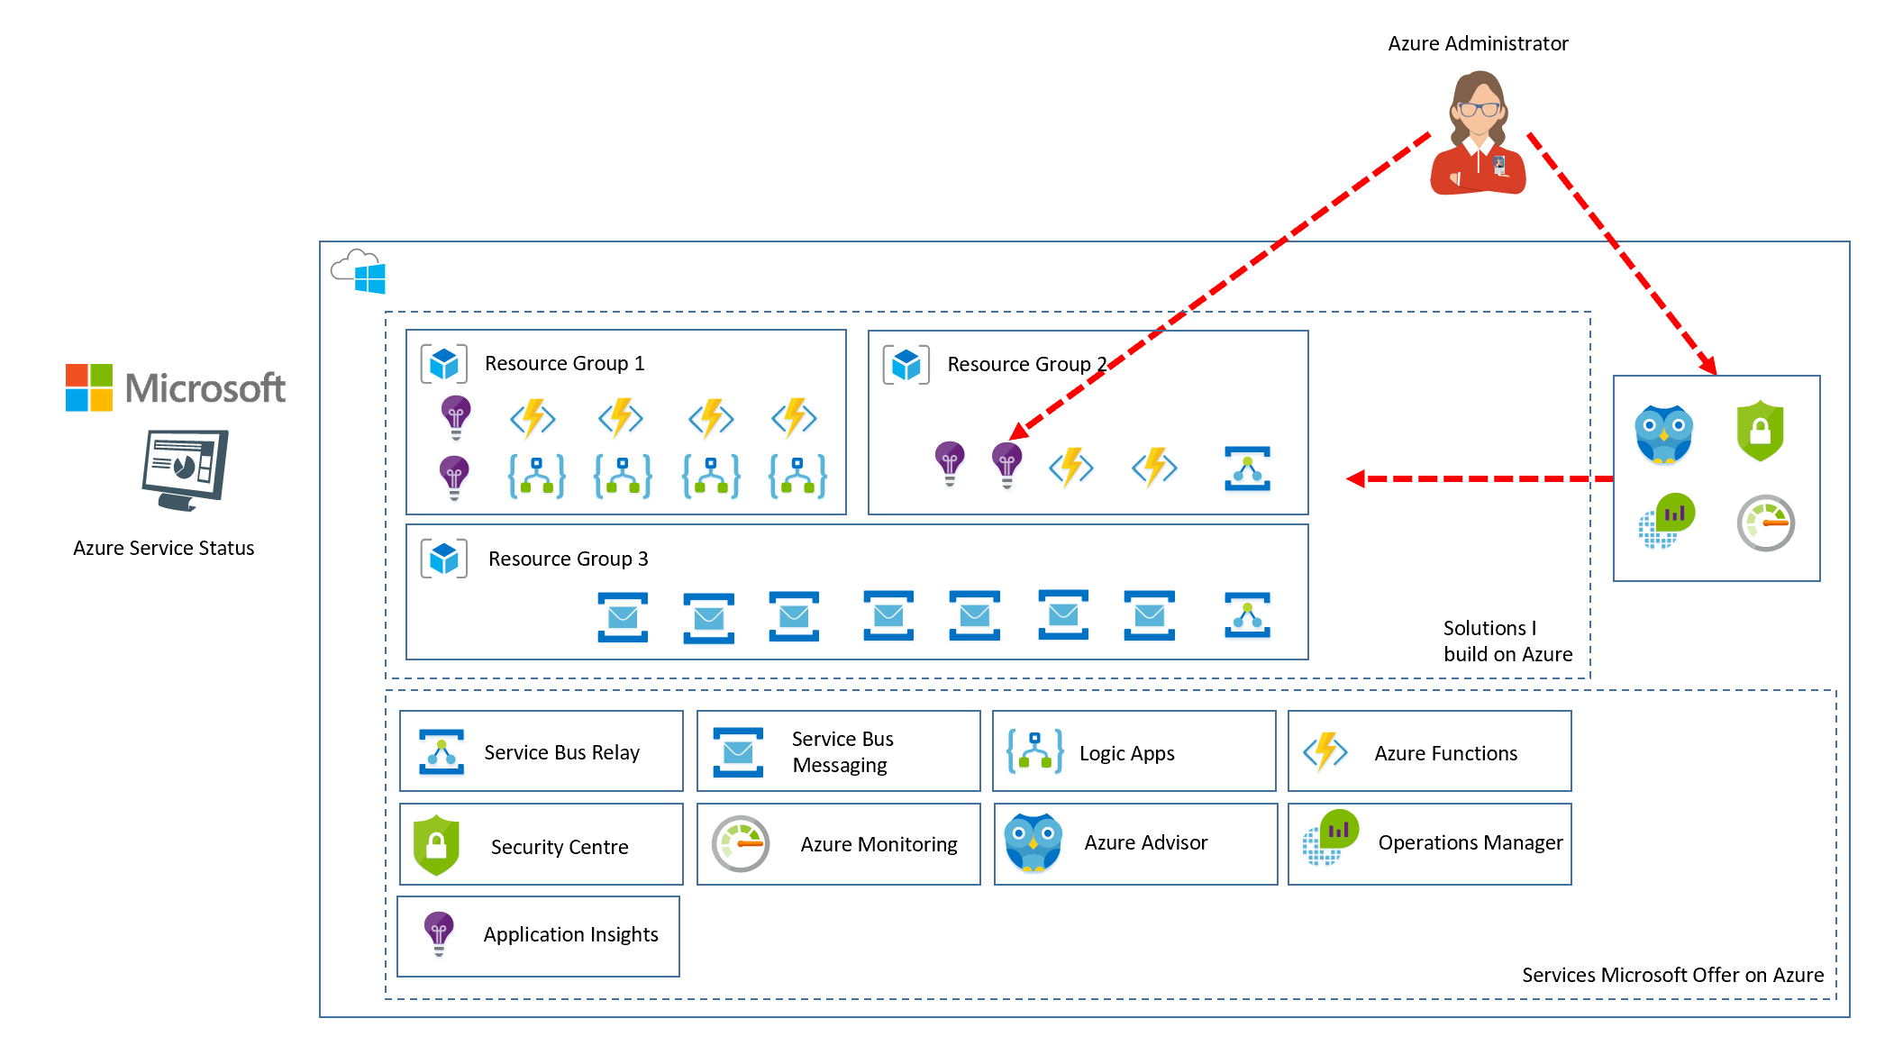
My Cloud Admin

Slide 6
Reality
I don’t understand this cloud stuff
Order 123 is missing
Customer calls help desk
High Value,
Experienced Azure Resources
Product A looks wrong
One of our customers cant login
Help desk identifies it’s a cloud
issue so logs ticket and passes it on
Delivery teams have loads of unplanned
support tasks on top of delivering change

Slide 7
Reality of the Cloud Support Process
← Knowledge of Solution →
Business User
Low
Medium
High
Medium
1st/2nd Line Support Team
DevOps Team
Agile Development Team
Architecture Team
$
$$
$$$
$$$$
← Cost of Support Resolution →
Monitoring Tools

Slide 8
How to Achieve lower TCO?
% Breakdown of Support
(just a guestimate for customers doing cloud > 2 years)
Business User
5% now
50% + aim
25% now
25% + aim
60% now
20% + aim
10%
5% aim
1st/2nd Line Support Team
DevOps Team
Agile Development Team
Architecture Team
Monitoring Tools
How can we safely resolve more support issues to the left?

Slide 9
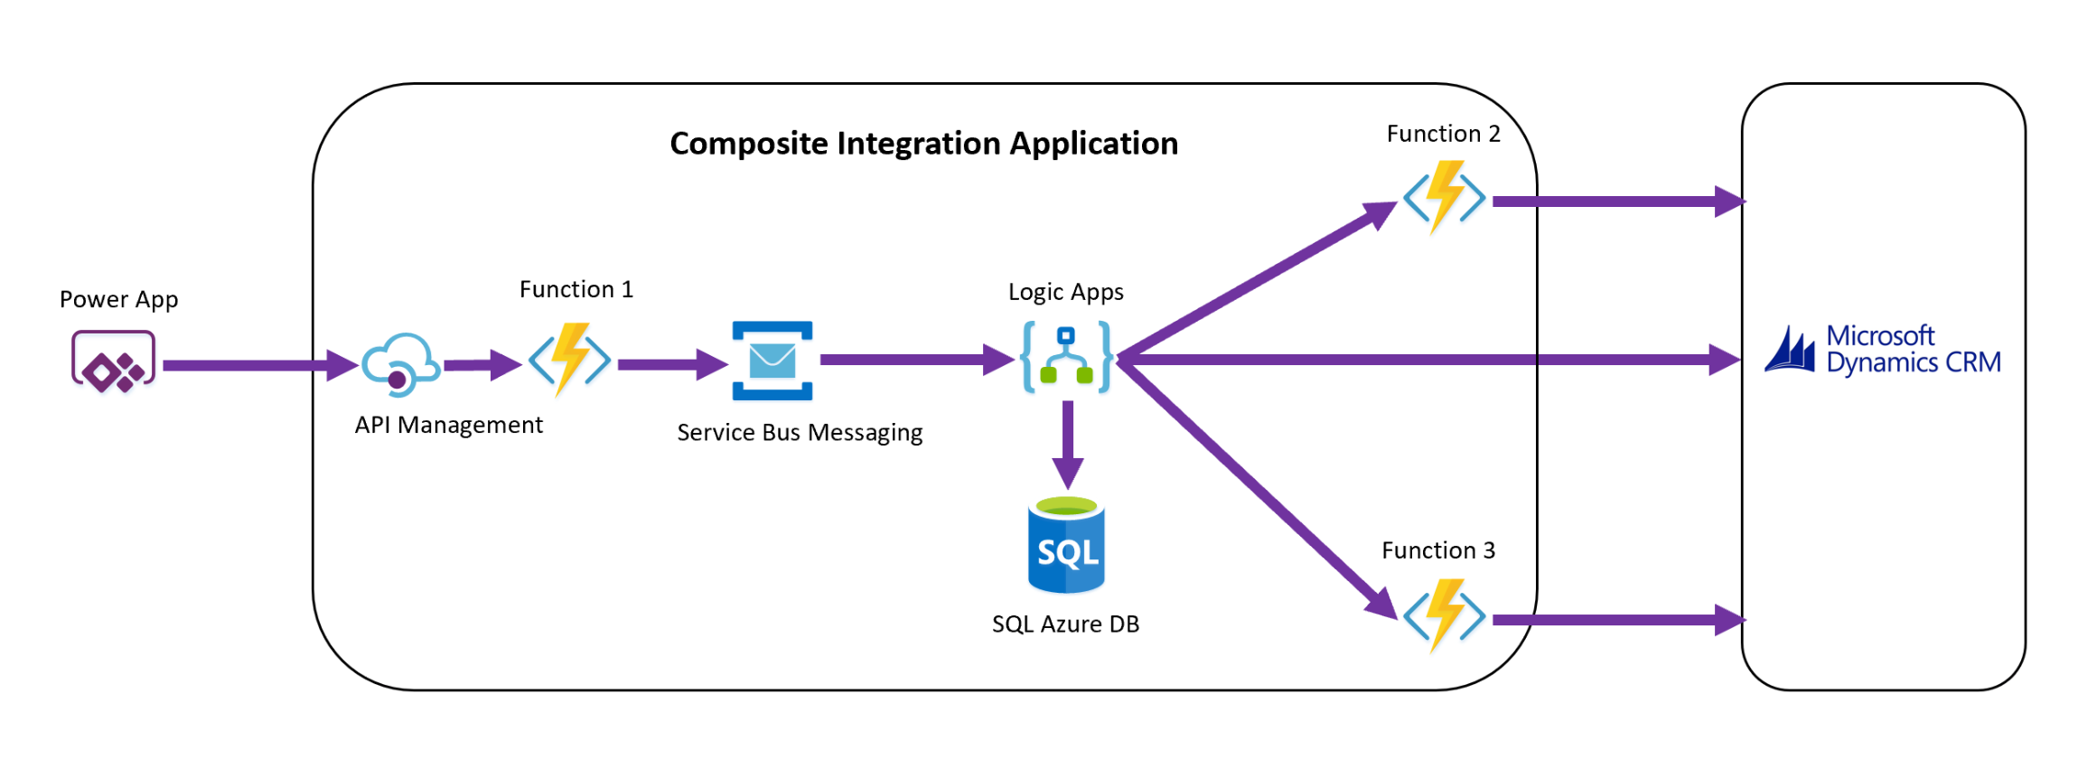
Composite Integration Applications is a solution to a Business Problem
Load Customer Orders
Notes:
Composite Integration Application:
Based on principles of Microservices
Logical Solution in a box
Composes multiple Azure services
Benefits
Easy to visualise
Deployment automation
Solves specific problems
Serverless optimises delivery
Challenges
Physical implementation is often more complex than the logical view

Slide 10
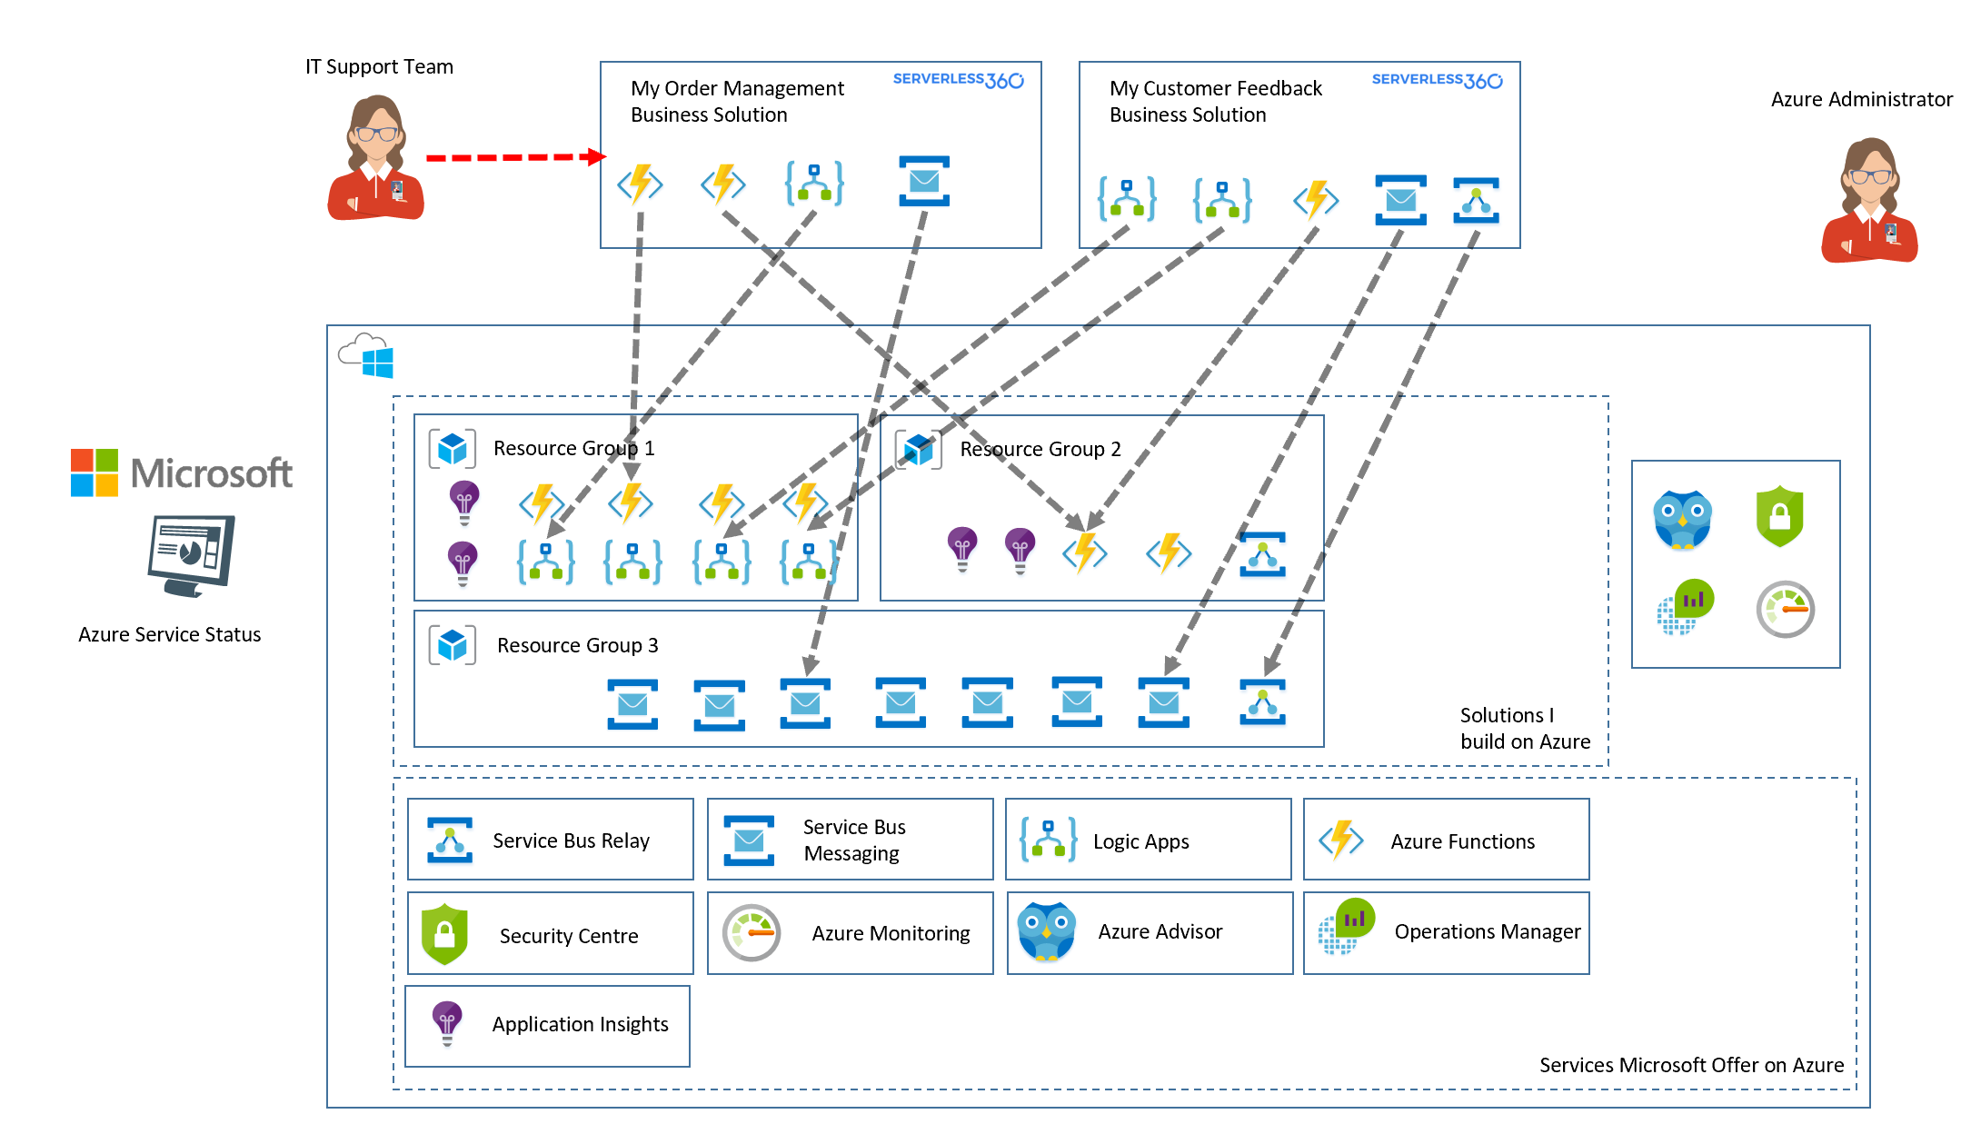
What my Support Team should do

Slide 11
Compare Perspectives
Support Manager
Is the business solution working
Is the platform working
Azure Admin

Slide 12
3 ways Serverless 360 helps my support team

Slide 13
We don’t understand the technologies used in the solution
I don’t understand what we have in Azure
We seem to be spinning up stuff all of the time, what does it do
Support Manager
CTO
Project Manager

Slide 14
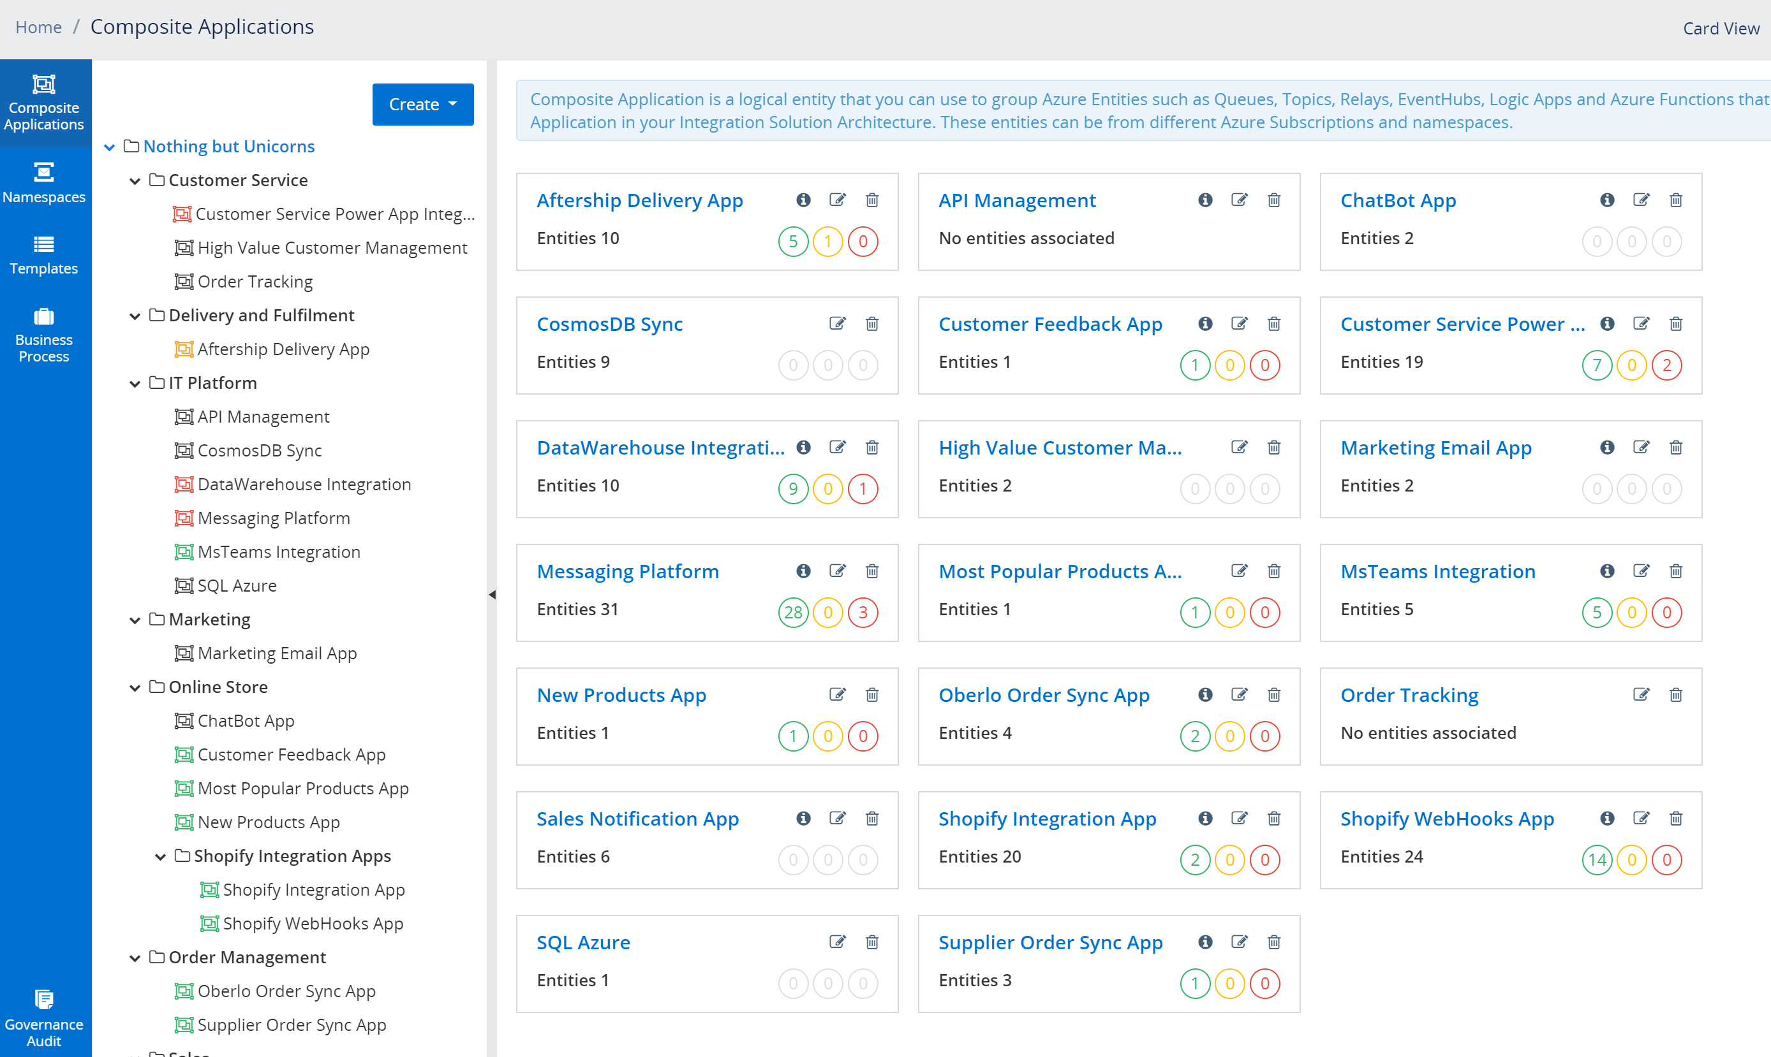
Composite Application Estate
Try the tree view and group your solutions into logical areas of the business.
You don’t need to be an expert in the technologies, just learn how to operate the composite app

Slide 15
Its like a candy box for my developers, they have choices but how does it fit together
We cant support the solution as we cant workout what services do what and how they work together
Ive thousands of resources in Azure, what do they all do
Support Manager
CTO
Project Manager

Slide 16
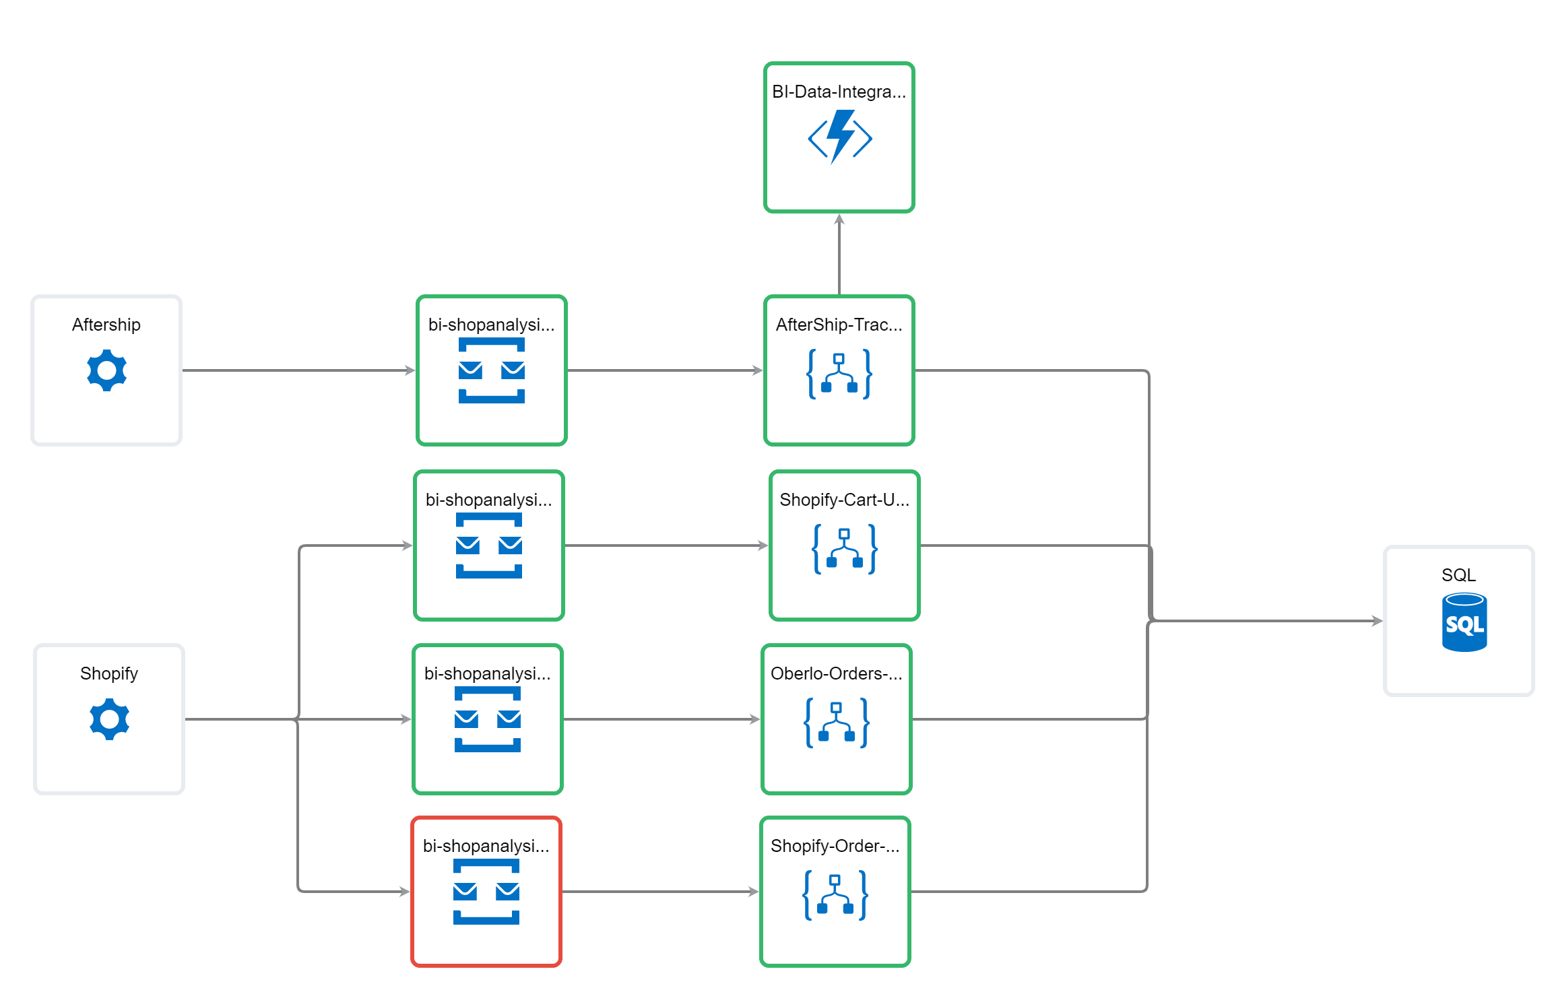
Service Map / Topology
The topology diagram lets you communicate how the resources work together to deliver the business solution.
You can even see which ones might be having problems in their current state

Slide 17
My delivery team have no capacity from chasing those orders
We cant access the systems or see whats going on to support the solution, we need to give it to the dev team
We always seem to be chasing around orders
Support Manager
CTO
Project Manager

Slide 18
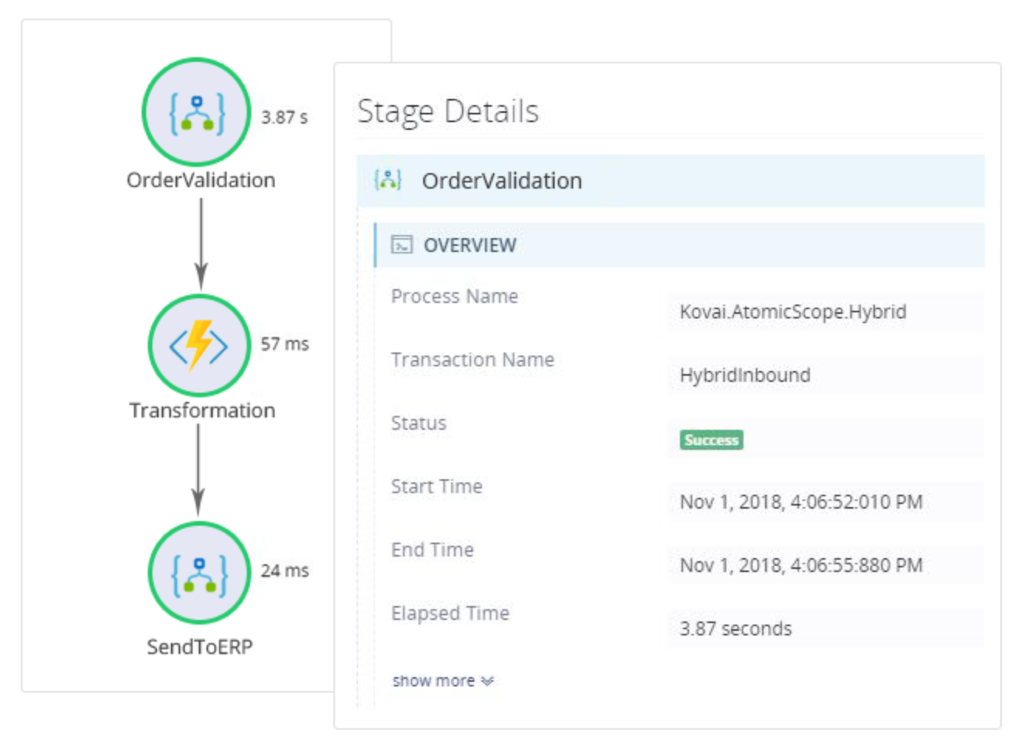
Business Activity Monitoring
With BAM we can track the execution of transactions within a business process.
We can see problems and replay messages to fix things if needed

Slide 19
Let’s Dive Deeper on BAM

Slide 20
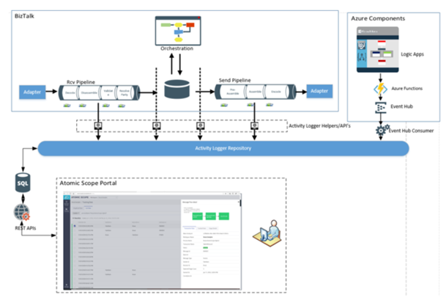
Now: Atomic Scope Architecture
For BizTalk Customers
For BizTalk + Azure Customers
Deploy on your own Infrastructure (on premise or cloud)

Slide 21

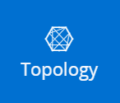
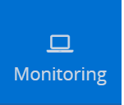
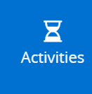

New: SL360 BAM powered by Atomic Scope
Benefits
View Business Process Transactions in Serverless 360
Simplified SaaS provisioning (we setup and manage Atomic Scope infrastructure behind the scenes)
Many customers asking for combo of these 2 products
(Its embedded within SL360)

Slide 22
Simple Demo
Bam in <5 minutes

Slide 23
Using it in the Real-World

Slide 24
Most Popular Products
Customer driven feedback drives most popular products

Slide 25

SQL Azure DB
Shopify Webhooks end up in SQLDB
Enterprise Application Platform
Refresh Most Popular Products Logic App
Nightly Trigger
Clean Collection
Get Most Popular Products
Add Product to Collection
Online Store

Slide 26
Demo

Slide 27
High Value Customers
VIP customers with high life time spends we like to pay close attention to their orders

Slide 28
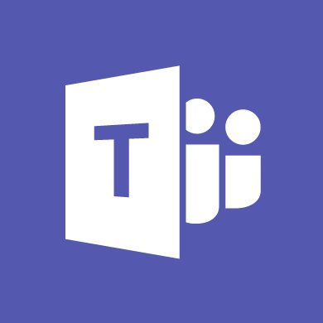
Power Apps
Microsoft Teams
SQL Azure DB
Enterprise Application Platform
Queue Trigger
Update order as high value
Notify VIP team
Record to BI database
High Value Customer Order Updates
Shopify Webhooks = Order updates on Service Bus
Online Store

Slide 29
Demo

Slide 30
Product Updates
Multiple things happen from a product update

Slide 31
Power Apps
CosmosDB
Microsoft Teams
SQL Azure DB
Product List update
Update Product
Catalogue
Product Price
Changes
BAM Transaction
BAM Transaction
BAM Transaction
BAM Business Process
Enterprise Application Platform
Online Store

Slide 32
Demo

Slide 33
Data Sources for BAM
Queue
Logic App
Function
API Management
Custom Code

Slide 34
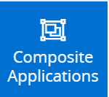
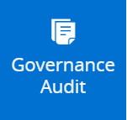
Key Features to Democratise Support
I can visualise my Azure Estate and know what goes where
I can visualise how the app works
I can securely perform management actions
I can monitor to see if my service is operating properly
Support Manager
I can troubleshoot problems with individual transactions
I have least privilege access and auditing of who does what

Slide 35
Questions

