Slide 1

Divya Swarnkar
Senior Program Manager - Microsoft
Enterprise Integration using Logic Apps
Notes:
In this session we put our enterprise hat on and talk about how all the cool stuff we are doing comes together to build enterprise solutions

Slide 2
Enterprises from our lens
Diverse and large network of personas and applications.
Embrace and lead innovation
….and do it before competition!
Incremental approach
We are in this together, your goals are our goals !

Slide 3
Innovate
Analyze
Measure
Logic Apps Platform
Faster and Agile
Secure and compliant
Scalable
Intelligent

Slide 4
Contoso Grocery Store
Current state
Grocery items are wasted when storage units malfunction
Repairs are multistep process – identify problems, order parts, schedule maintenance and then fix problem.

Slide 5
Contoso Grocery Store
Installed IOT sensors to the storage units, equipped their staff to receive Notifications
Logic App IOT trigger >> Message transform >> Notify Store team >> Create maintenance order SAP
SAP send equipment change request >> Message transform >> Create workorder in D365 >> Notify Maintenance team

Slide 6
Demo

Slide 7








Application network
ISE

Slide 8
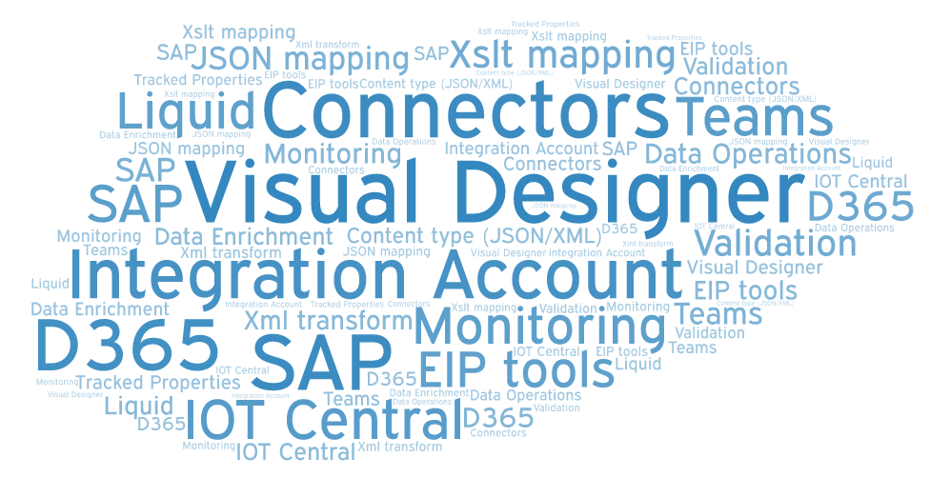
Recap

Slide 9
New Improvements
Integration Account (Standard)
  Limits for EDI artifacts raised to 1000
AS2 v2
  Is core action – more performant, no limit on timeout
Monitoring
  Batch trigger/action – monitor batch activity, release criteria, correlate items in batch
  Source run of resubmitted run

Slide 10
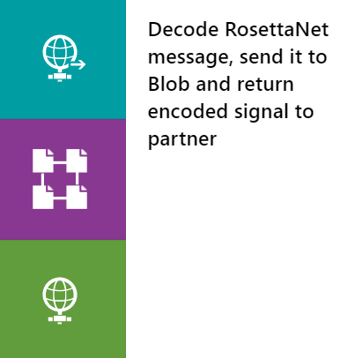
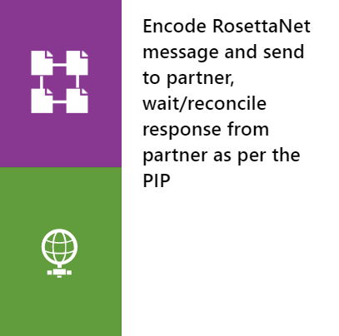
Announcing today…
RosettaNet public preview
Buyer
Seller
PO Request Action
Based on RNIF 2.0
Supports Decode, Encode and wait for response
Signal (receipt Ack)
2 hr
PO Confirmation Action
24 hr
Signal (receipt Ack)
PIP INTERACTION (3A4)

Slide 11
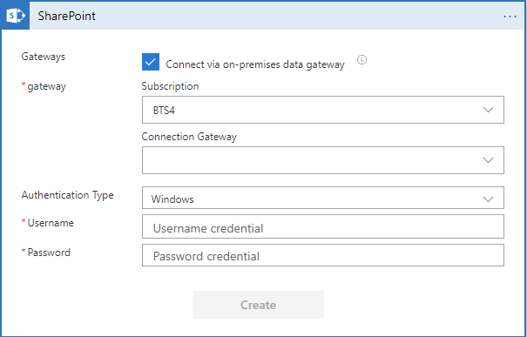
Coming really soon….
Data gateway across subscriptions

Slide 12
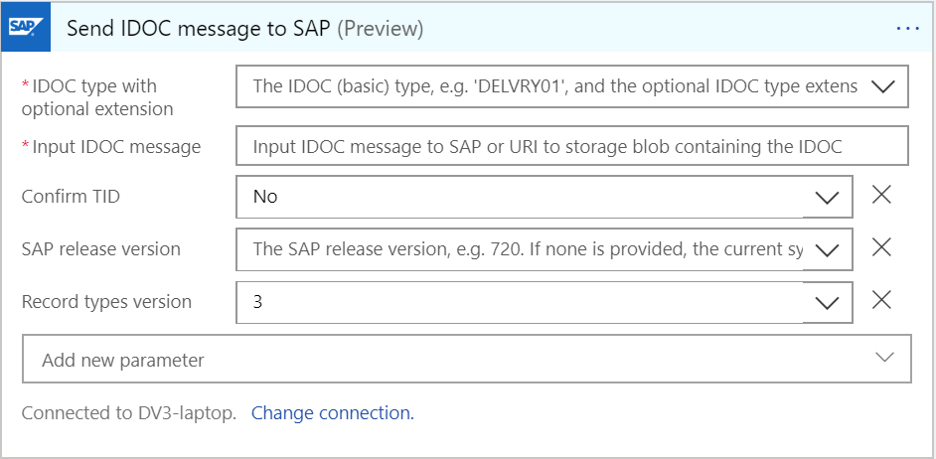
Coming really soon….
SAP connector more stuff
Name based discovery of IDOC/BAPI/RFC
IDOC packet support
IDOC tRFC confirm transaction

Slide 13
Coming really soon….
GA of SFTP-SSH connector
SAP connector for ISE

Slide 14
Coming soon….
EIP tools for VS 2019
Integration Account UI improvements
More core connectors (EDI, Service bus)
Performance improvement of connectors (SQL, Oracle, SFTP,…)

Slide 15
Future roadmap
Industry verticals
Business verticals - healthcare (HL7)
Connectors -Oracle EBS, Netsuite, ODBC
Connector marketplace
Configuration store
Integration Account – dev SKU, DR
Monitoring
Azure AppInsights support for Logic Apps

