Slide 1
Derek Li
Program Manager, Microsoft
Hacking Logic Apps

Slide 2
Hacking Logic Apps
Derek Li
Shae Hurst
Program Manager
Software Engineer

Slide 3
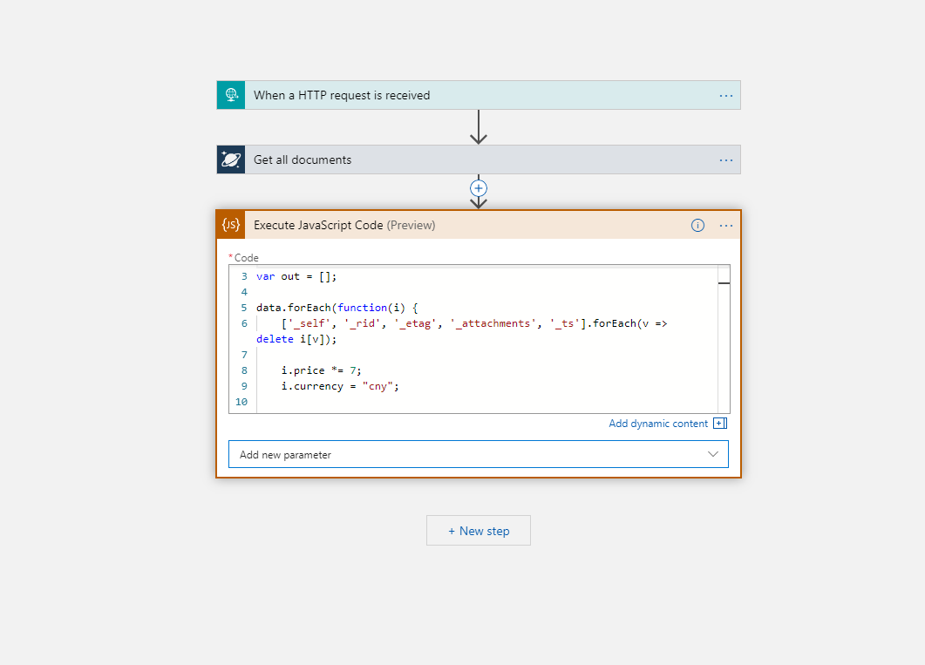
Inline Code
Why did we do it?
When there’s already Azure Functions

Slide 4
Demo
Inline Code

Slide 5
Inline Code
What’s next?
Inline Code in ISE
Inline Code w/o IA
Premium inline with IA – bigger content size, more execution time
JavaScript .require(‘module’)
PowerShell / C#

Slide 6
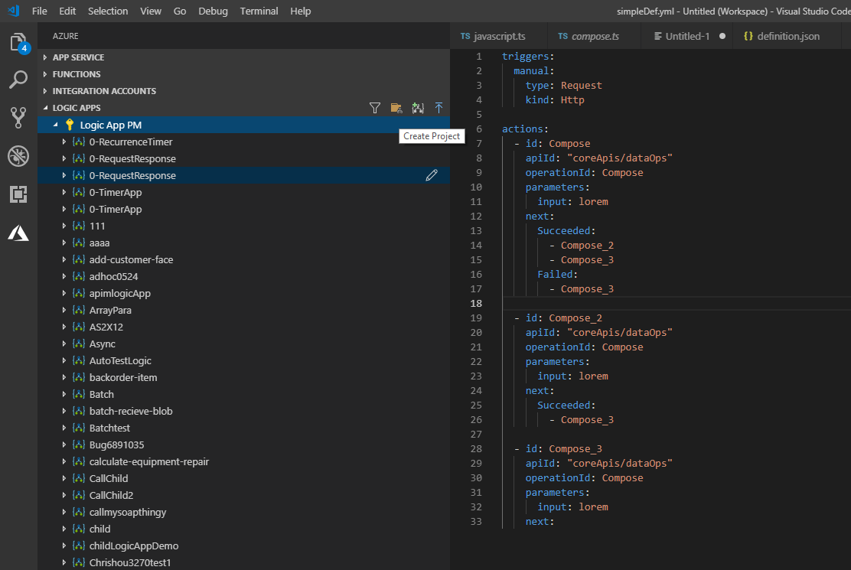
VS Code
What’s new?
Local project
ARM template generation
Azure DevOps integration

Slide 7
Demo
VS Code - DevOps

Slide 8
VS Code
What’s next?
Better template gen
Connection management experience
Designer improvements

Slide 9
First 10 people with an approved pull request get a one-of-a-kind t-shirt.
github.com/microsoft/vscode-azurelogicapps

Slide 10
Tips of the trade
Logic Apps

Slide 11
Trigger Condition
Instead of using ‘Condition” right after trigger, you can check for conditions in the trigger
No run if condition is not met – cleaner run history, reduce cost
"triggers": {
"manual": {
"conditions": [
{
"expression": "@equals(triggerOutputs().body.foo, 'bar')"
}
],
"inputs": {
"schema": {}
},
"kind": "Http",
"type": "Request"
}
}

Slide 12
Run against older versions
Work on the request trigger
Use with API-M to slowly direct traffic to newer version
POST /workflows/{workflowId}/versions/{versionId}/triggers/manual/paths/invoke
// API Management Policy
<set-variable name="i" value="@(new Random().Next(100))" />
<choose>
<when condition="@(context.Variables.GetValueOrDefault<int>("i") < 20)>
<rewrite-uri template=""/>
</when>
<otherwise>
<rewrite-uri template=""/>
</otherwise>
</choose>

Slide 13
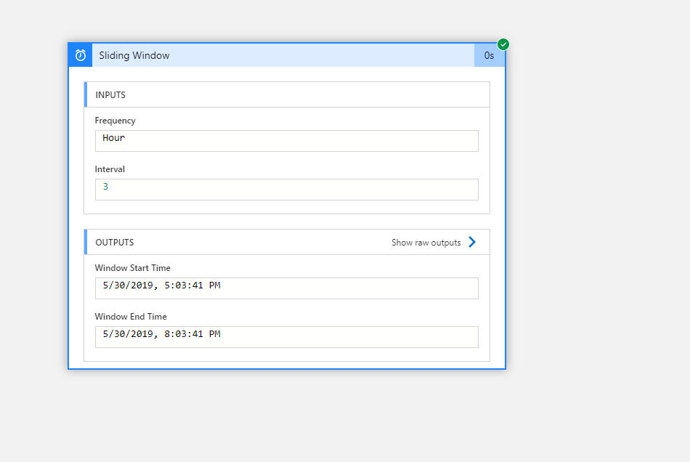
Sliding Window Trigger
Sliding Window Trigger
Not the recurrence trigger you knew

Slide 14
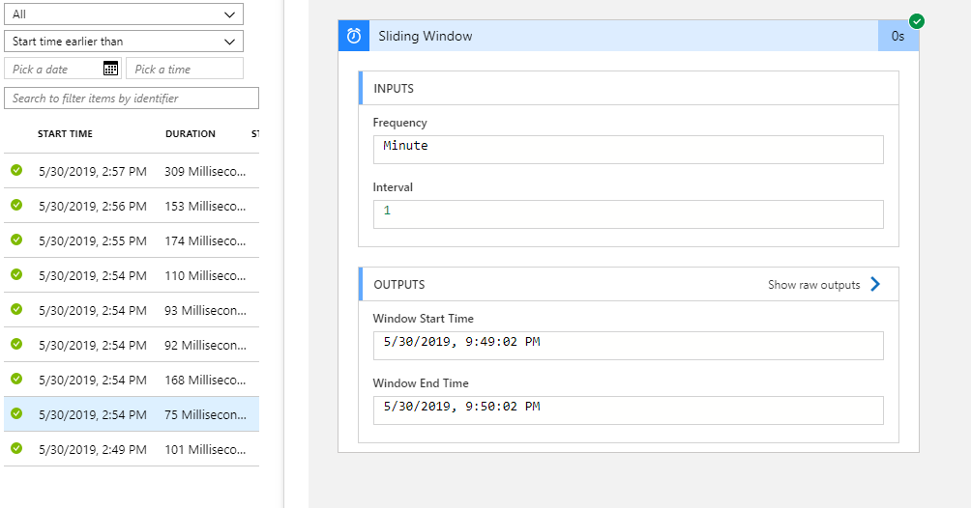
Sliding Window Trigger
Fix-sized, non-overlapping, and contiguous time intervals
Back-fills in case of engine downtime, disabled LA, or long running singleton task
Output start/end time, useful for resubmission

Slide 15
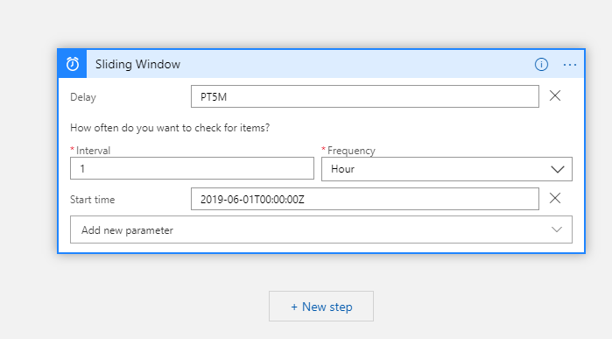
Sliding Window Trigger
Trigger delay
Doesn’t change start/end window time
Great for data processing tasks that involve late arrival data

Slide 16
What’s on Derek’s Mind? (SFW)
A Sneak Peek Into

Slide 17
Things we’re considering…
Emoji generator connector

Slide 18
Things we’re considering…
Emoji generator connector
More inline code & VS Code
New designer
Better token picker

Slide 19
429s
429s 429s 429s 429s 429s 429s 429s 429s 429s 429s 429s 429s 429s 429s 429s 429s
Where are 429s coming from?
Connector – most often
Service the connector connects to
Connector throttling model
Per connection in consumption
Per connector in ISE

Slide 20
429s
How to improve
Use a singleton Logic App to call connector to avoid parallel branches/instances fighting over rate limits
Use different connections per action/Logic App
Use multiple connections per action
"$connections": {
"value": {
"servicebus_1": {...},
"servicebus_2": {...},
"servicebus_3": {...}
}
"connection": {
"name": "@parameters('$connections')[concat('servicebus_', rand(1,3))]['connectionId’]
}

